Slide 1

Know Before You Go: Guide to Purchasing Your First Vehicle
JMAC Group: SNHU Capstone Project 2022
Joseph Pfankuch
Maria Martinez
Andrea Douglas
Corey Johnson
Notes:
Andrea
Good evening – my name is Andrea Ceste Douglas and I am here with my colleagues of the JMAC Group: Corey Johnson, Maria Martinez, and Joe Pfankuch. We will be taking this time to discuss the different factors a first time car buyer should consider when purchasing a used vehicle – which we have then constructed within a framework to be utilized within educational settings.
(22 seconds)

Slide 2
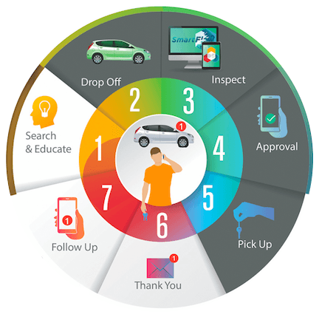
5 Why/ Investigative Analysis
Notes:
Andrea
Purchasing a first vehicle is a rite of passage - most often the very first single largest purchase that a young person independently makes. Then why is it that there is virtually no formal education regarding key factors to consider when making this big decision? Typically, teens and young adults rely on informal, anecdotal advice from family members or older friends. Here at the JMAC Group, we recognize the importance of providing a formalized analysis, tailored to teens and young adults, ages 16-21, to provide guidance on the critical aspects of making their first purchase of a used vehicle.
(40 seconds)

Slide 3
Overview
Who we are/ Hypothesis
Target Audience
Outline/ KPIs
Data deliverables
Conclusion
Notes:
Andrea
This evening, we will discuss:
Resources used & techniques for data extraction and cleaning
Demographics of our stakeholders and
Four key indicators
First - Financing – FICO Score and variations in APR
Second – Budget, costs of the car, cost of ownership, and insurance premiums
Third - Value & Depreciation – comparing price to market, inventory and value over time
And lastly - Safety ratings and accidents
(30 seconds)

Slide 4
Scope & Hypothesis
Iseecars.com “Best Used Cars < $15k” have the highest safety rating and lowest costs of ownership
https://www.iseecars.com/articles/best-used-cars-under-15000
Notes:
Andrea
Within the scope of the analysis, we will benchmark ISeeCars.com “25 Best Used Cars less than $15,000” – we hypothesize that those vehicles that ISeeCars.com identified will have the highest safety ratings and lowest cost of ownership.
(18 seconds)

Slide 5
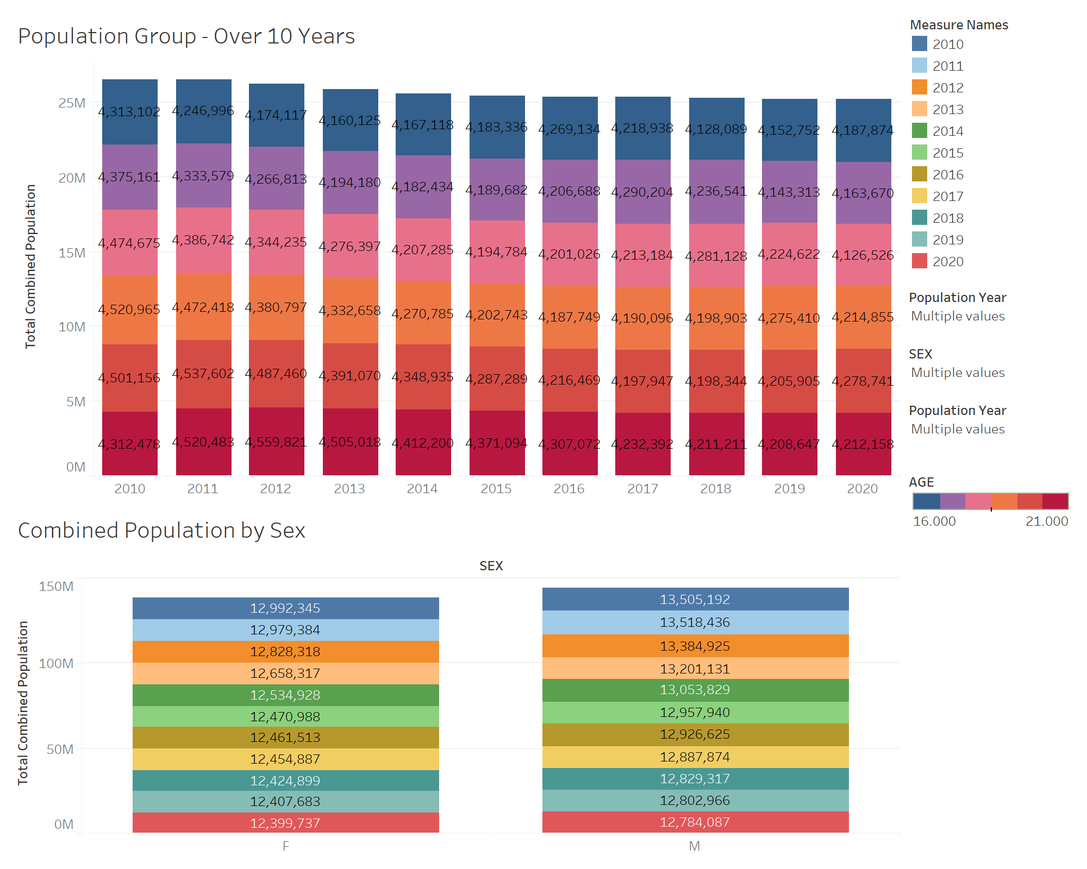
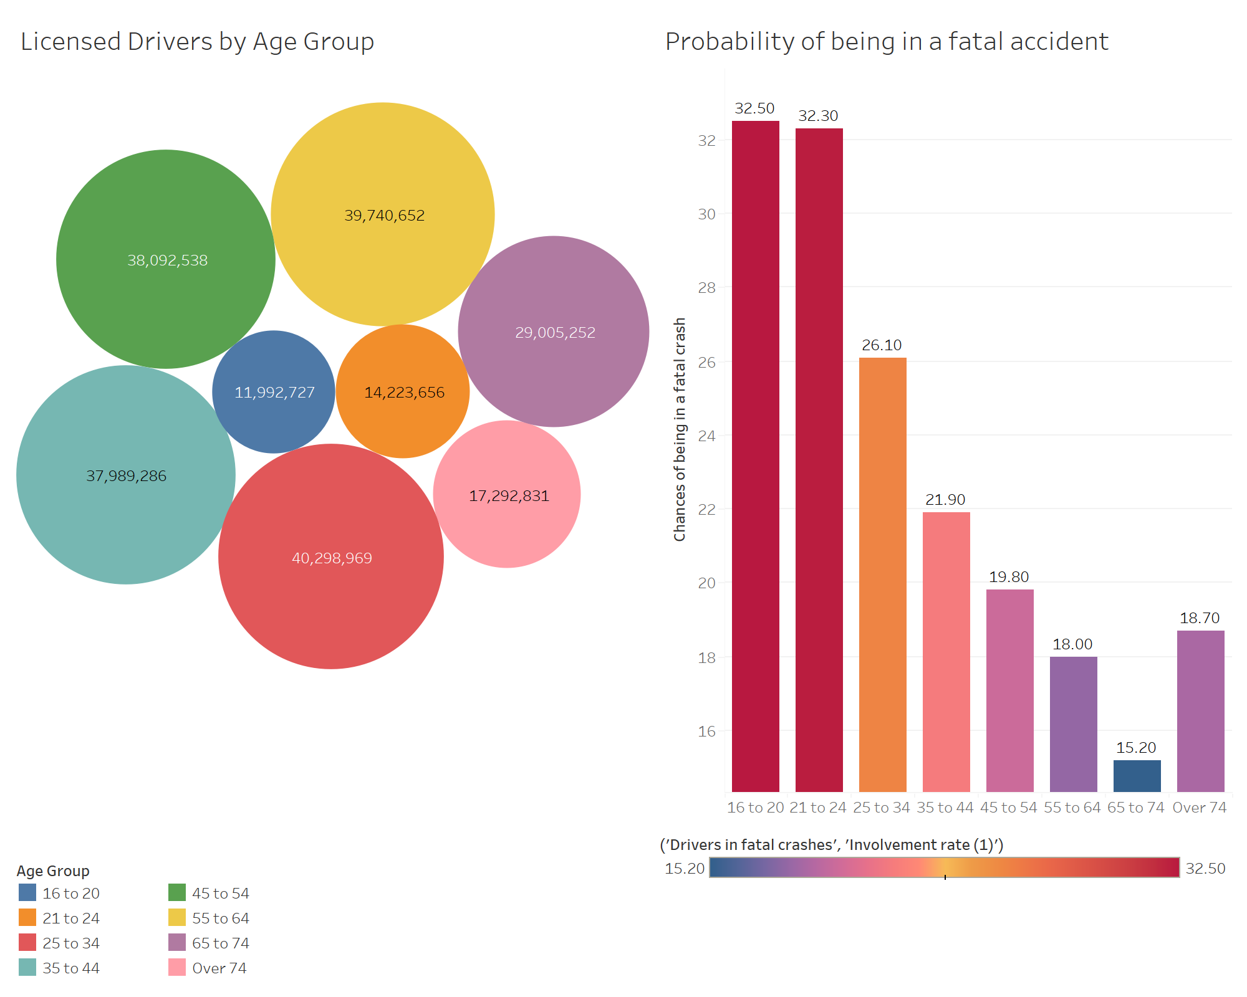
Stakeholders
Young Driver: 16 to 21 years of age; GDL program; inexperienced; low credit ratings; lower income.
Notes:
Corey Notes:
Since Personal & Financial Responsibility are subjects rarely taught to young adults, our stakeholders are the young adults, ages 16 – 21, who dream about buying that first used car. Accounting for about 40% of yearly car sales, these your drivers are starting to do more research than any other group on what to buy and our project is aimed at assisting them in their research. To be clear, we are defining young drivers as persons 16 to 21 years of age operating a motor vehicle. People in this age group generally obtain their licenses for the first time and many are under graduated driver licensing (GDL) programs as they learn driving skills. These young, inexperienced drivers have higher crash rates and lower credit scores when compared to more experienced drivers across the United States.
Unlike
Dashboard 01: 2020 Census – USA Young Adult Population
Licensed Drivers: Licensed Drivers

Slide 6

KPIs – Factors to be considered
Financing
Costs
Cost of the car
Cost of ownership
Insurance premium
FICO Score
Variations in APR
Safety
Safety Ratings
Accidents/Fatality
Value & Depreciation
Comparing price to market
Inventory
Value over time
Notes:
Notes:
Now that we have identified our stakeholders, let us dive into the Factors to be considered, otherwise referred to as our Key Performance Indicators or KPIs. The insights gathered in the areas of Financing, Costs, Value & Depreciation and Safety will provide crucial insights that will help our stakeholders to make better decisions going forward.

Slide 7
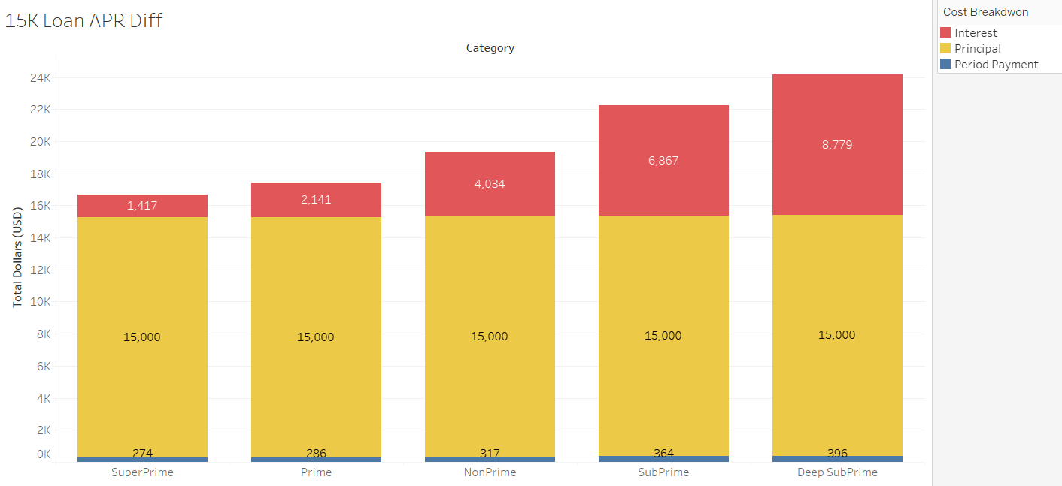
FICO Scores
What is a FICO score?
Why is it Important?
Visuals
Interest rate
Loan amount
Categories
Notes:
Maria
FICO Dashboard – FICO Comparison X1
When looking to make a purchase of a vehicle, lenders will automatically look at a consumer’s FICO Score. A FICO score is used to “shine light” into an individual’s financial background, as they reveal payment history with managing debt and overall credit worthiness.
It is important to keep a credit score active and in good standing as it can affect finances and the ability to achieve long-term goals, such as owning a home, PURCHASING a vehicle, and believe it or not obtaining your dream job.
Our visual demonstrates bar charts that entail: Interest, Principal and Period Payment for each Category when it comes to differentiating a 15K loan with APR Differences.
Categories are broken down by SuperPrime, Prime, NonPrime, SubPrime and DeepSubPrime. Ultimately, they are the credit scores reporting from DeepSubPrime which are in the very low 300s to SuperPrime to anything reporting at 781 and higher.
The loan amount for all categories stays consistent, however when diving in deeper, we see less interest being paid on SuperPrime when compared to every other category along with a lower term when it comes to the breakdown.

Slide 8
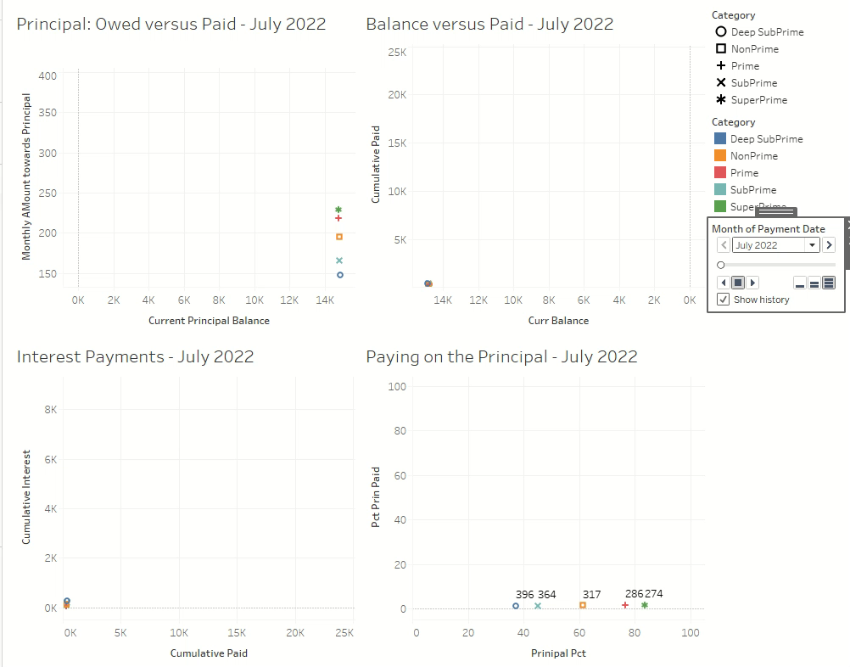
Financing Comparison (FICO)
Watching the points converge:
Owed versus Paid
Interest Payments over time
Balance versus Paid
Paying on the Principal
Notes:
Corey Notes:
In this visual, which we refer to as the fireworks show, we have four representations of how the FICO APR affects the loan.
The first is a comparison of how the balance is affected by the principal.
The second is a comparison of what was paid versus the cumulative interest.
The third is a comparison of what was to be paid to pay of the balance.
The fourth is a comparison of the percentage of the payments towards the principal versus the percentage of the principal paid.

Slide 9
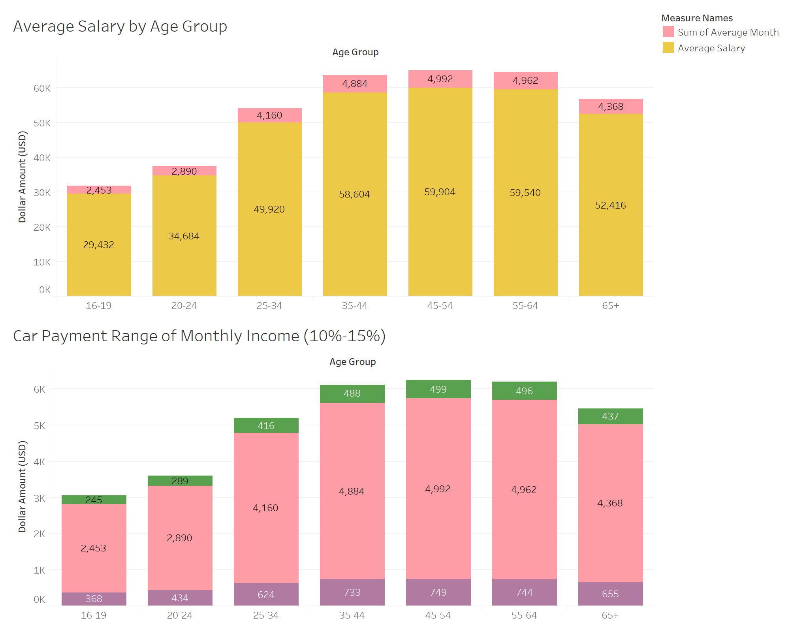
Considering a Budget
Average Salary (16-19):
$29,242 annually
$2,453 daily
Recommended car payment:
> 10% $245
< 15% $368
Average Salary (20-24):
$34,684 annually
$2,890 daily
Recommend car payment:
> 10% $289
< 15% $434
Notes:
Notes:
According to a recent article by Smart Asset, our stakeholders average a paycheck between $566 and $667 per week. When we factor in fiscal responsibilities, the price of vehicle ownership should lie somewhere between 10% and 15% of the income. This assists in them not living well beyond their means as well as setting realistic expectations on what they can truly afford.

Slide 10
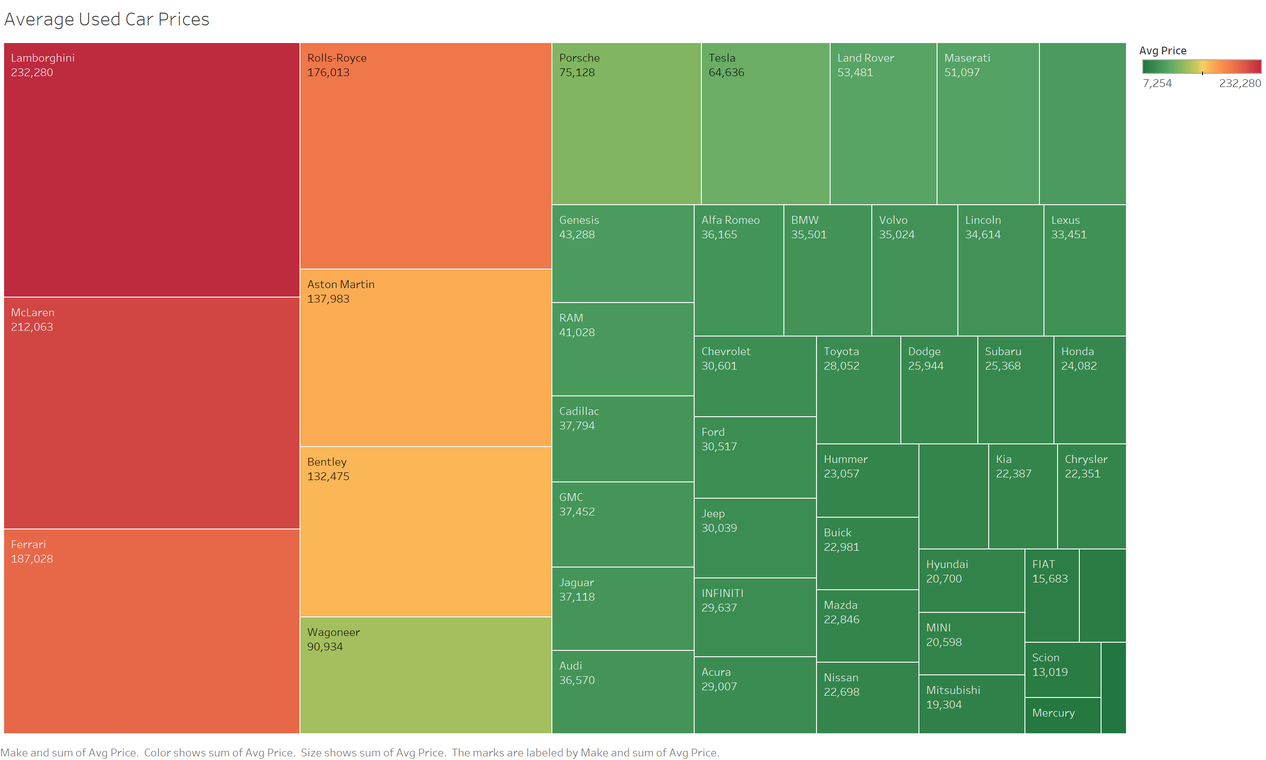
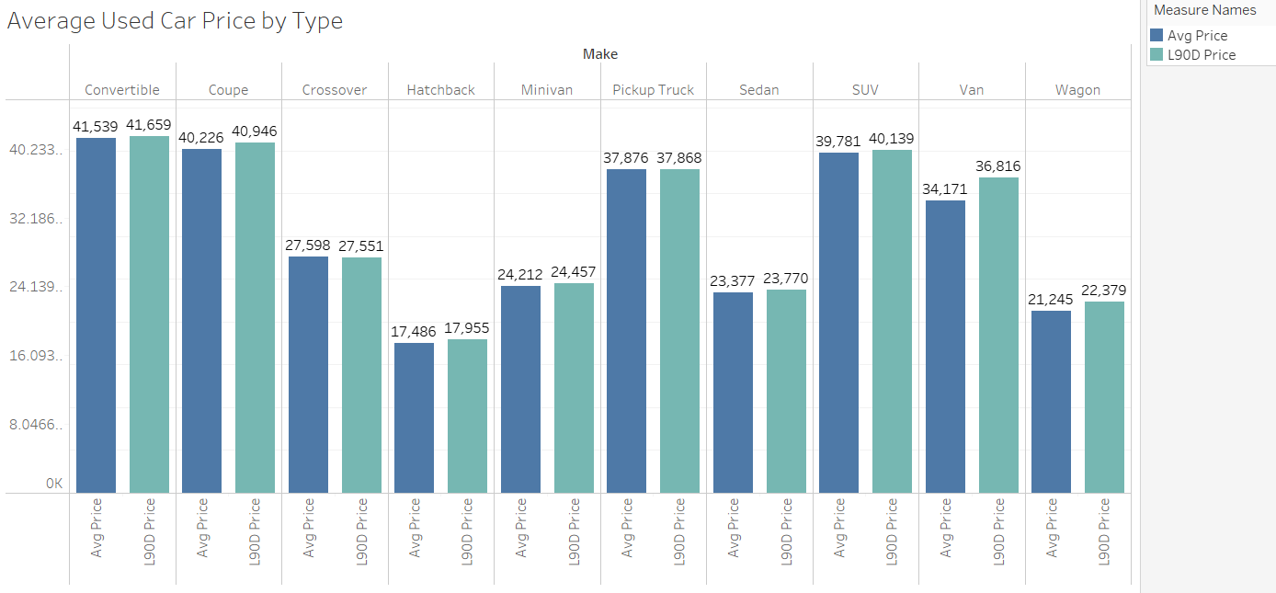
Cost of Used Car
Notes:
Maria
CarGurus – By Make
CarGurus – By Model
When purchasing a vehicle, its more than just driving it to Dunkin or Starbucks and getting an iced coffee every morning. It’s taking in consideration, registration fees, excises taxes as applicable, Maintenance, repairs, Depreciation, along with gas and yes the car payment. The heat map on the left shows the Make and sum of Avg Price for vehicle types. Visual on the right shows: Avg Price and Last 90D Price for each Make. Color shows details Avg Price and L90D Price. Based on the data supplied and filtered, convertibles seemed to have higher averaged pricing by type when even compared to SUVs and Coupes.

Slide 11
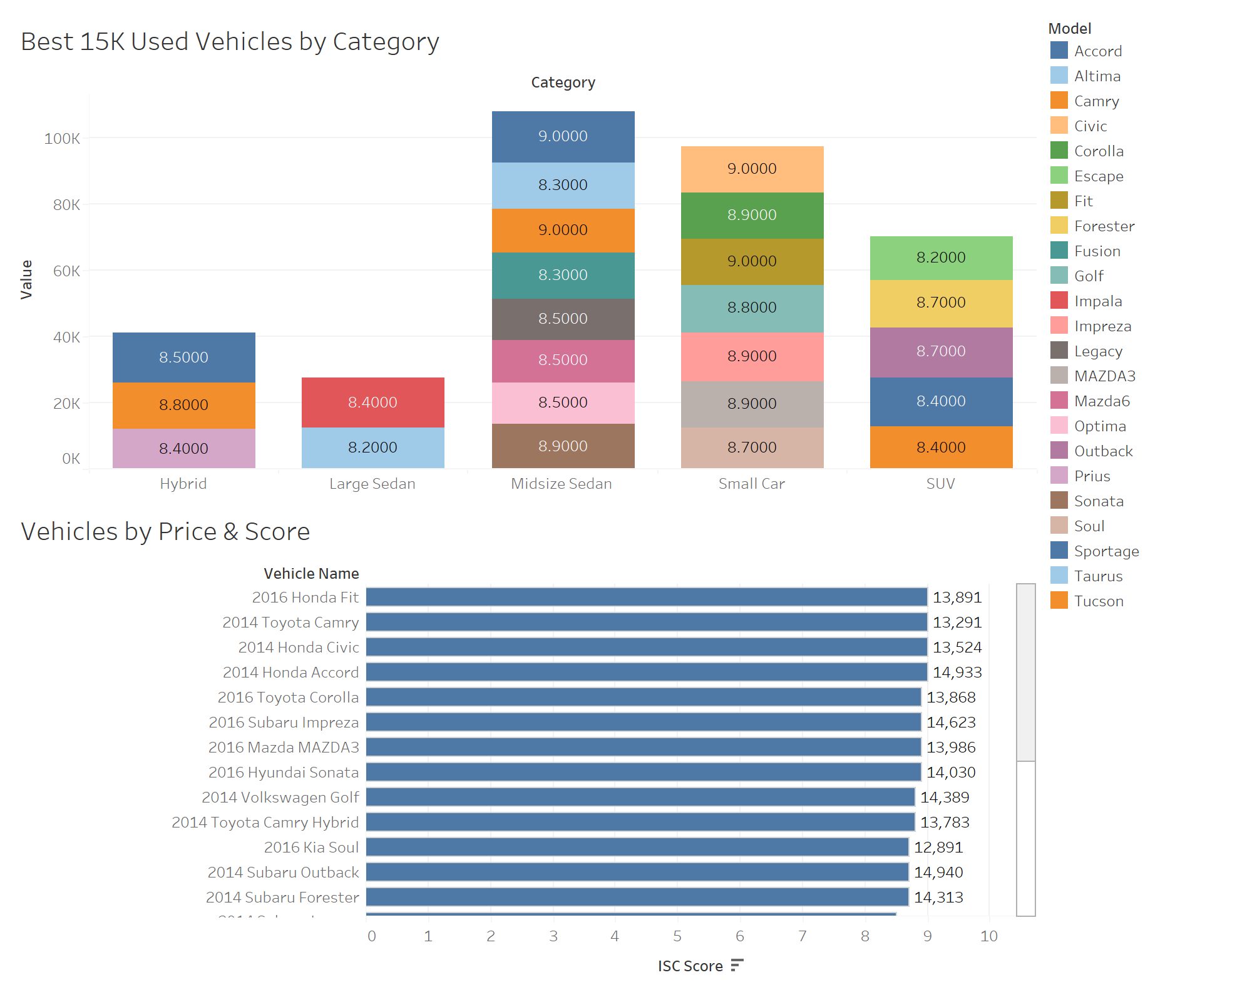
Best Used Cars < 15k
Factors:
Budget
Score
Make
Model
Year
Notes:
Maria
Identify best recommended cars for budget
For this visual we focused on the Best used cars under $15K. We figured this would be a reasonable budget range for the group we are targeting. What we found interesting was that Hybrid cars, along with midsized sedans and small cars had higher safety scoring than larger sedans and SUV’s. The bottom visual helped us use the Sum of “I See Cars” Score from a scale of 0-10 on our X axis and Vehicle names for our Y Axis. As for the top visual details the Type of vehicle, on X axis and Value on the Y Axis. Ultimately reflecting midsize sedans and small cars averaging higher ratings than all others.

Slide 12
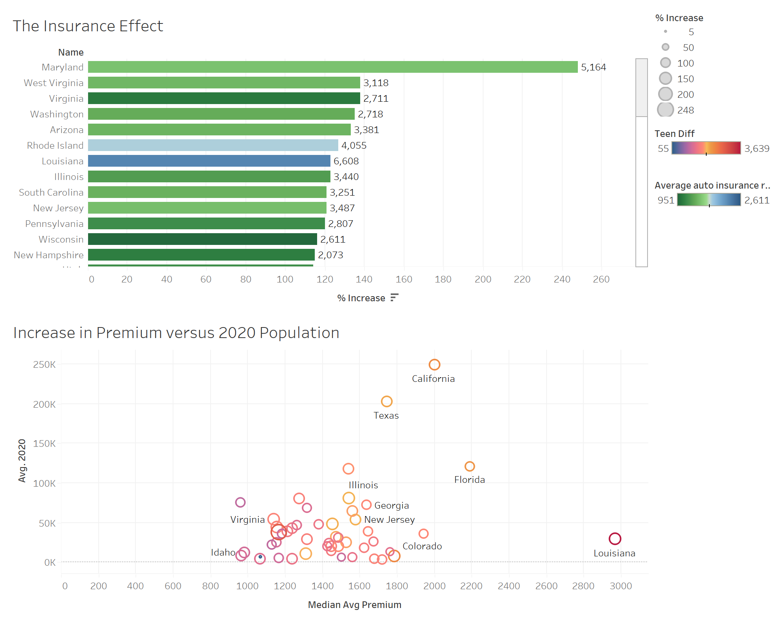
Insurance By State
Maryland with the highest increase in average premium (248%) between average annual premiums with teen drivers vs. without teen drivers.
Most populous states (California,Texas, Florida) tend to have the highest median average premium.
Notes:
Andrea
Talking points for hybrid in-class presentation:
An important financial consideration in the purchase process is the cost for auto insurance. The horizontal bar chart depicts the percent differences of policy premiums, by state, with and without teen drivers. Maryland with the highest increase in average premium (248%) between average annual premiums with teen drivers vs. without teen drivers.
The second visual represents the policy premiums by population of the state. Most populous states (California, Texas, Florida) tend to have the highest median average premium.
(35 seconds)
Additional talking points for the recorded presentations:
The horizontal bar chart represents the percentage increase of the insurance premium. Maryland has the highest increase in premium. The coloring represents the premiums without teen drivers (lowest premium amounts from darkest green to light green) and the highest premiums without teen drivers (from light blue to dark blue). The bars are marked with the dollar value of the premium with a teen driver.
The bottom visualization depicts the average population per state in 2020 on the Y axis and the Y axis average yearly premium. The size or the circles are indicative of the % increase between premium with vs. without teen drivers. The color of the circles range from lowest to highest dollar amount of premium cost differential with blues & purples the lowest dollar figures to step up to orange, yellow, and red for the higher premium cost differential. Most populous states (California,Texas, Florida) tend to have the highest median average premium with Louisiana as an outlier.

Slide 13
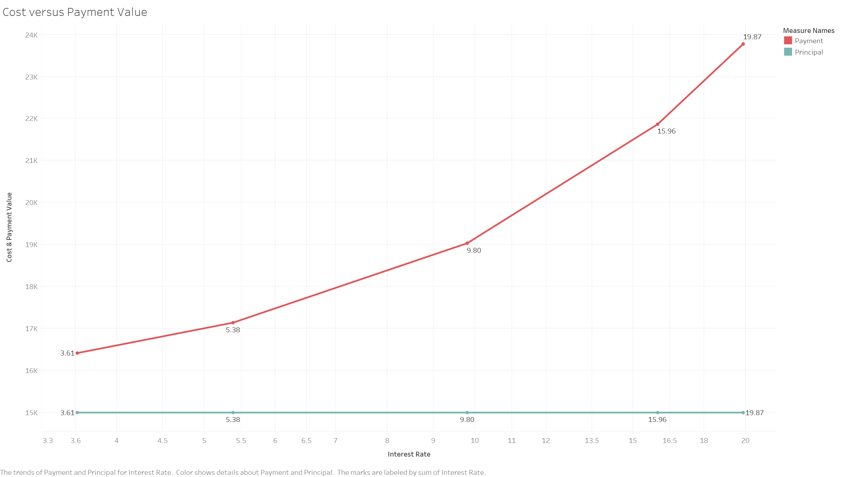
Initial Financing
Higher interest =
Higher overall total cost of payments throughout the life of the loan
Notes:
Andrea
This line graph depicts the interest rate vs. the total amount paid after 5 years. The lowest interest rate 3.61% shows payments totaling $16,417 over the life of the loan of $15,000. The line graph shows an increase in total payment as the interest rate rises, with a staggering total payment of $23,779 with an interest rate of 19.87% (30 seconds).

Slide 14
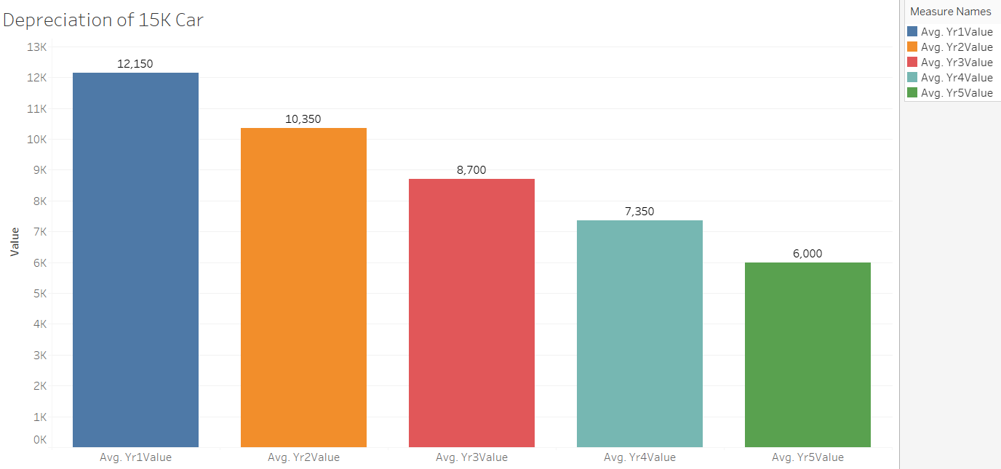
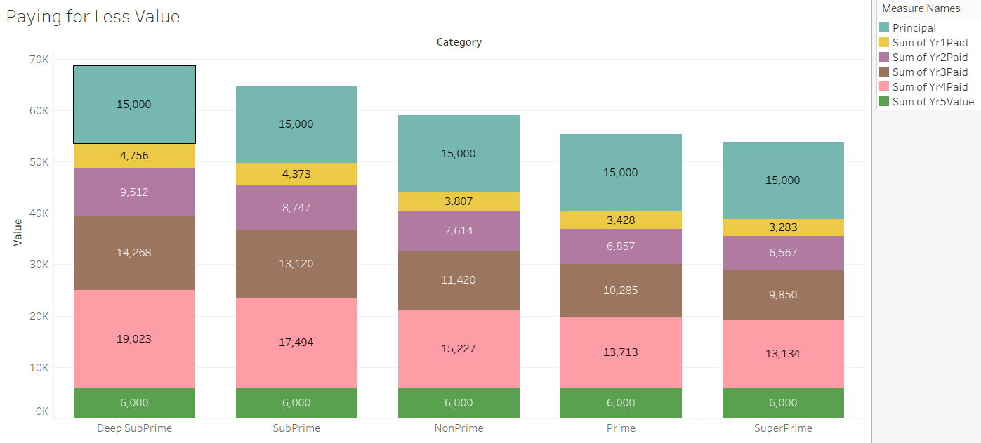
Depreciation (is just like gravity…)
Notes:
Maria
Dashboard 1: Depreciation X2
Depreciation is the biggest factor affecting the long-term value of a car and the total cost to own it. If money is borrowed to purchase a vehicle and the consumer then decides to sell it few years later, they may be upside down on the loan, or in other words owe more money than the car is worth. The visual on the left hand side shows the depreciation of a vehicle over a span of 5 Years owning it (roughly 1800 is lost on value as every year goes by). On the right hand side we see paying for less value based on the credit categories for which consumers fall into. The better the credit score the less you pay on interest, and the worse of the credit score the higher you pay in interest rates.

Slide 15
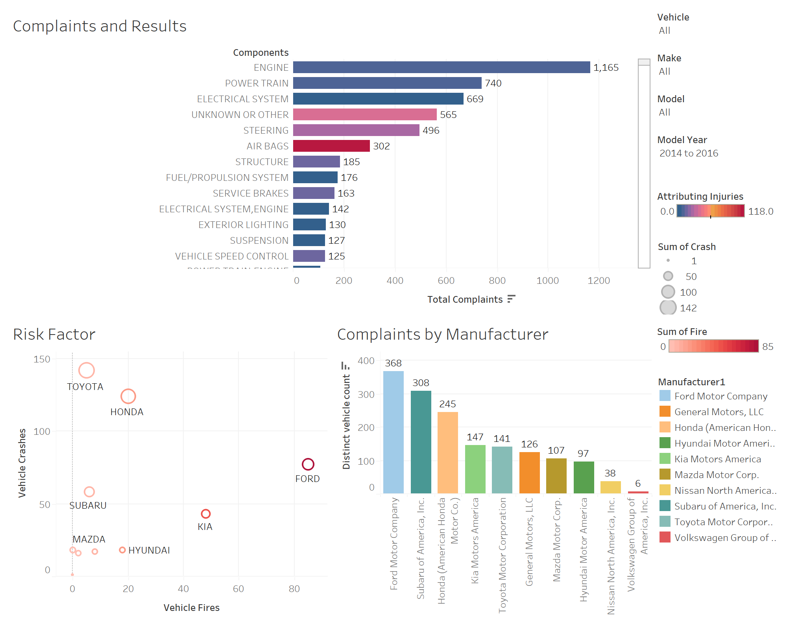
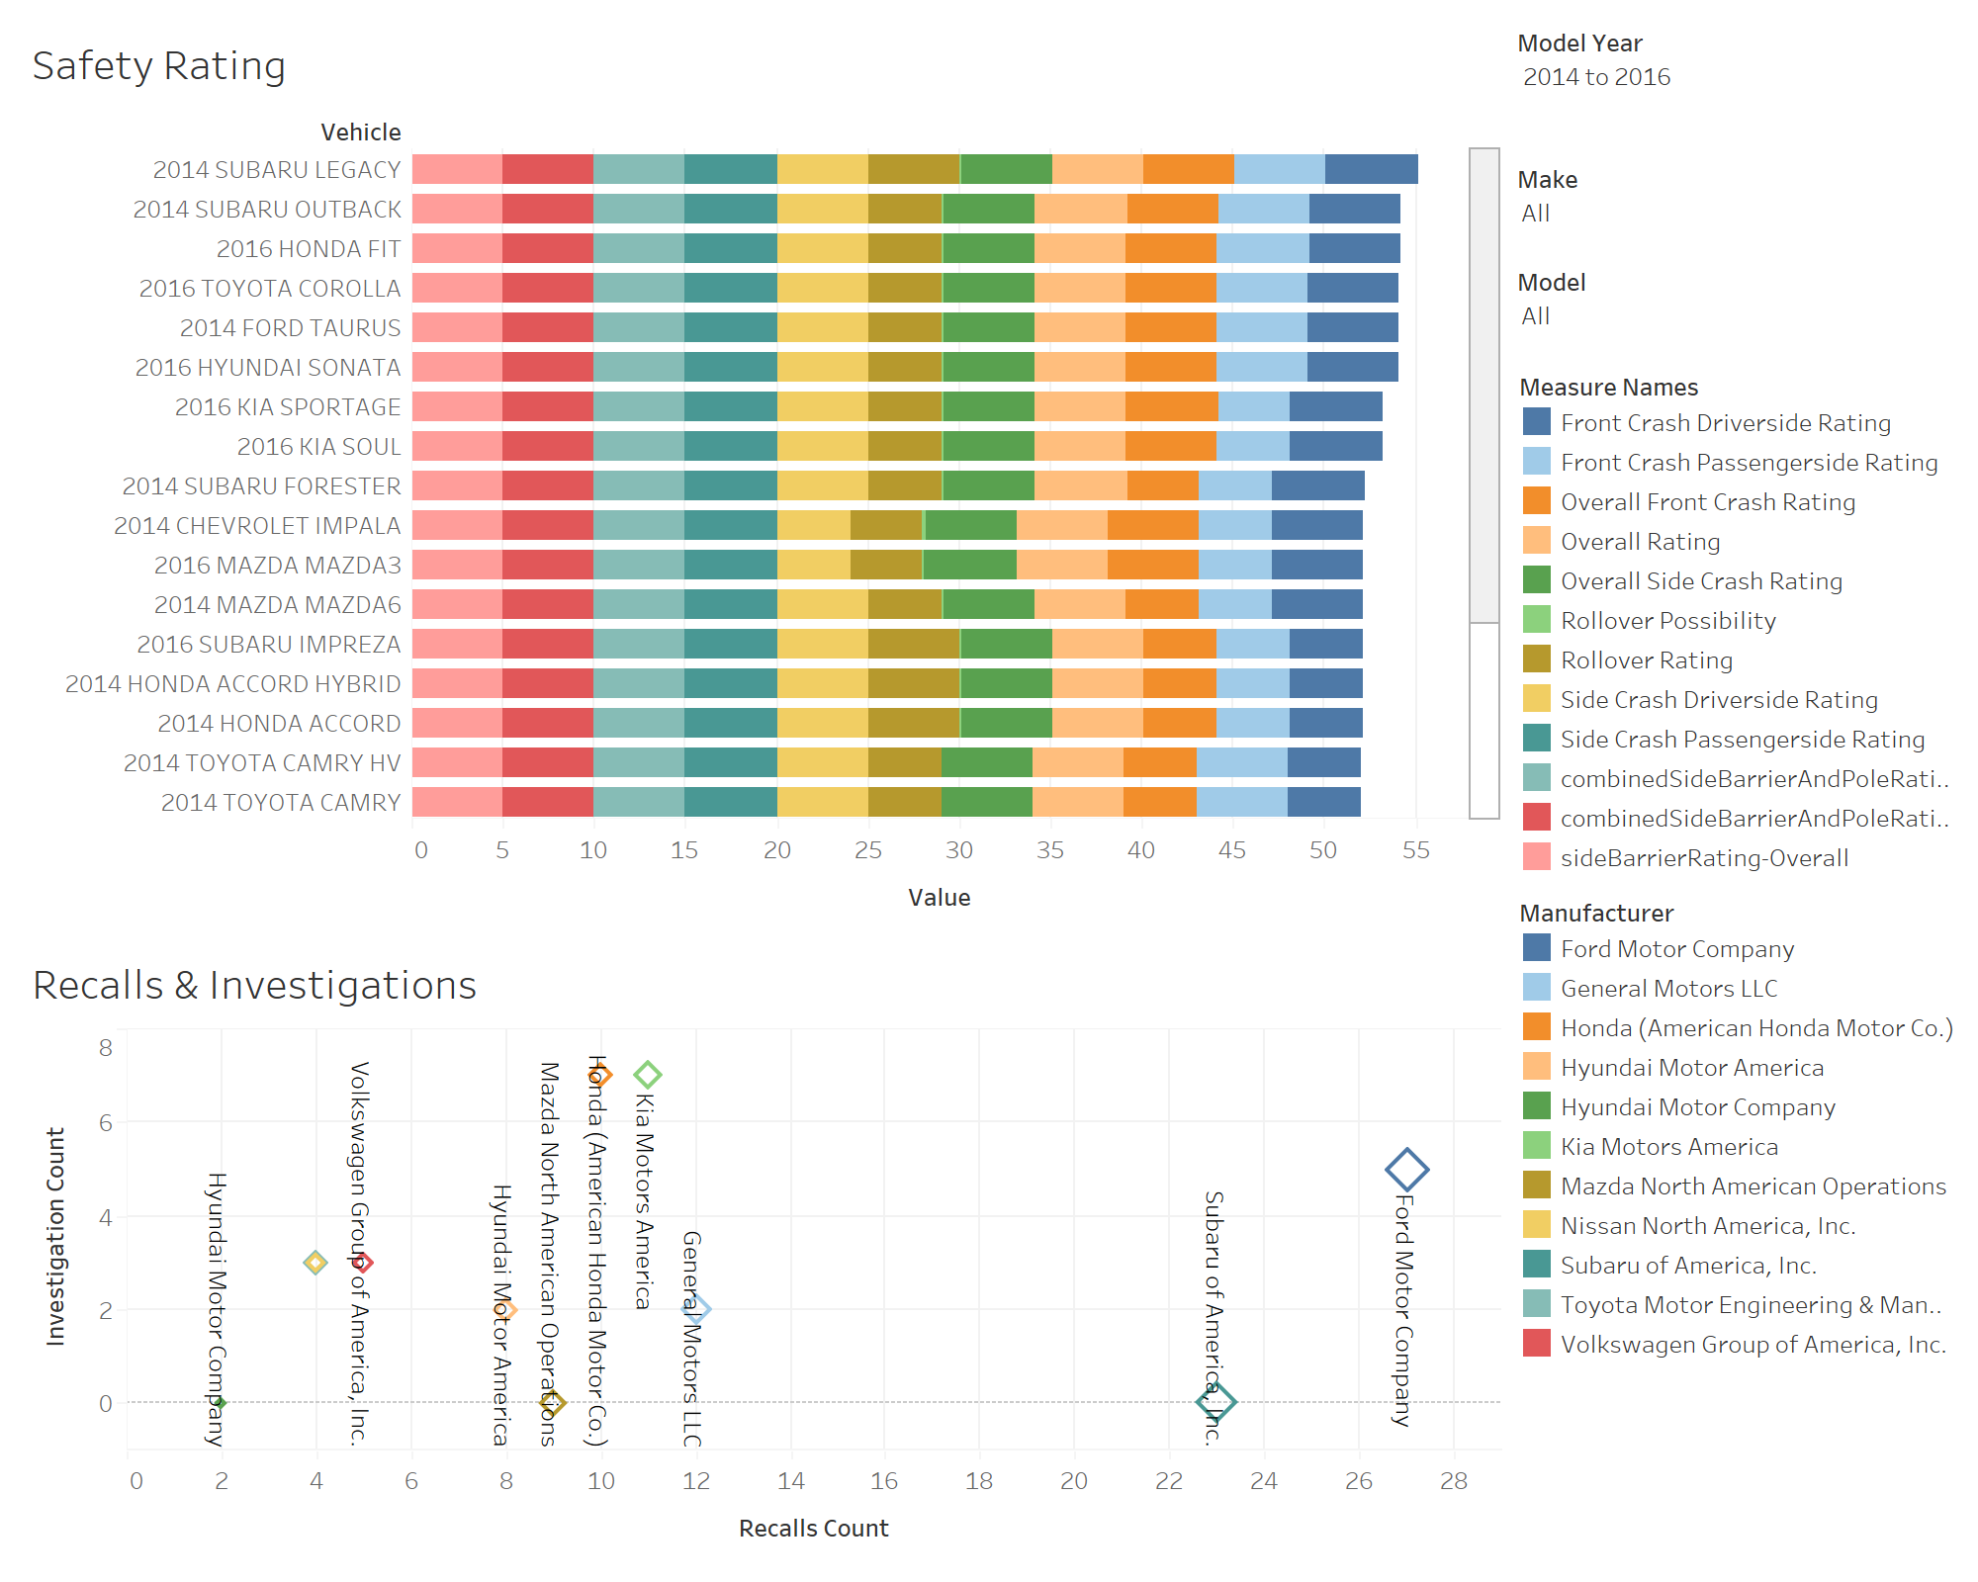

Safety Ratings
Visit the National Highway Traffic Safety Administration for additional information.
Notes:
Corey
Regardless of the car you buy, whether new or used, everyone should be encouraged to review the ratings about the vehicle they intend to purchase. Knowing how a vehicle rates in a collision or accident, the number of complaints by model, the risk for vehicle crashes and fires and which components are known to fail are all factors that our stakeholders should consider when making that purchase.
NHTSA Dashboard 2: NHTSA Vehicle Assessment
NHTSA Dashboard 1: NHTSA Vehicle Assessment

Slide 16
KPIs – Combining all Factors
Financing
Costs
Cost of the car
Cost of ownership
Insurance premium
FICO Score
Variations in APR
Safety
Safety Ratings
Accidents/Fatality
Value & Depreciation
Comparing price to market
Inventory
Value over time
Notes:
Now that we’ve reviewed all of our KPIs, let see what message we can relay to our stakeholders.

Slide 17
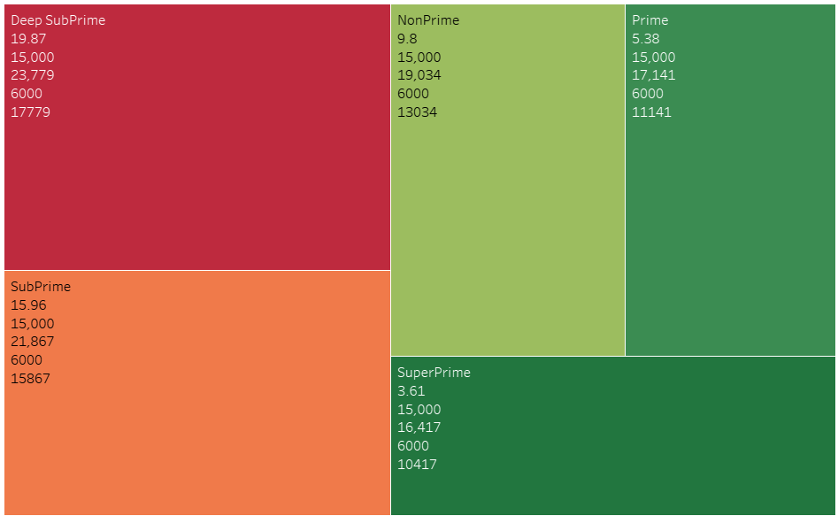


Comparison: Cost vs. Value
Notes:
Maria
Show difference between car cost and worth
When purchasing a vehicle, its important to take in consideration the investment one is making when comparing the value VS cost. Factors that directly influence the value are: the vehicle’s age, mileage, condition, optional equipment, and even the region where it’s being sold. The heat map shows the breakdown of how much each category pays when it comes to taking out a 5 year loan term. SuperPrime, shows an interest rate of 3.61% at a 15K starting balance, payout of totaling $16,417 depreciation of 6K and value standing at 10,417. When compared to a really bad credit category with same staring balance of 15K but now the differences are clearly shown that the interest rate is higher, total payout over the 5 year term is much higher the depreciation stayed the same, but the value of the car decreased. Causing vehicle to be upside-down or underwater for value. Some good resources that one can use when looking for historical data or value for a vehicle, are CarGurus, CarFax, Kelly Blue Book among others.

Slide 18


Python Libraries
import requests,pandas as pd import numpy as np import json from pandas import json_normalize #from fuzzywuzzy import fuzz #from fuzzywuzzy import process from dash import Dash, dcc, html import plotly.express as px import numpy_financial as npf import math import statistics import numpy as np import scipy.stats import matplotlib import matplotlib.pyplot as plt import seaborn as sns import statsmodels.api as sm from pathlib import Path import requests # library to handle requests from bs4 import BeautifulSoup # library to parse HTML documents
Notes:
Joe
When starting out looking at the technical aspects of the Data sets the first thing that we needed to accomplish was determining the Python Libraries that we would need to import and use to be able to effectively gather the data together. Some examples of these libraries are Pandas, Fuzzy Wuzzy, Matplotlib and Numpy to name a few.

Slide 19




Data Accumulation Techniques
API Queries
JSON Data Gathering and processing
Web Scraping
Notes:
Joe
With the libraries being setup then we will move into the data gathering process. The three main methods that were used in the programming process was API Queries, JSON data gathering and web scraping. We were pulling API information from the NHTSA Vehicle API site and processing the output JSON data into Excel spreadsheets for later processing. There were other sites such as Nerd Wallet, Car Gurus, and Car Insurance.com were sites that were also scraped for real time data for later processing and filtering.

Slide 20
Python Products
Use of four different Jupyter Notebooks for data gathering
First Book – Bulk Data Gathering
Second Book – Vehicle Detailed Safety Info
Third Book – Creating and Processing Financing Rates
Fourth Book – Gathering Recall information
Notes:
Joe
With the amount of data that was being gathered and processed we broke the tasks of gathering, and initial filtering and processing into four different Jupyter Notebooks. The first of the notebooks was used for gathering a bulk of the initial first layer of data. That would be car prices, initial vehicle safety information, Salary groups, FICO score interest rates, cost of ownership by state and vehicle depreciation numbers. The Second notebook focused on specific vehicle detailed safety information and country of origin data. The Third Worksheet is gathering, processing and breakdown different models of financing rates based on credits scores. The fourth and final workbook covers the gathering of vehicle recall information based cars that are listed as the most popular cars under $15k.

Slide 21
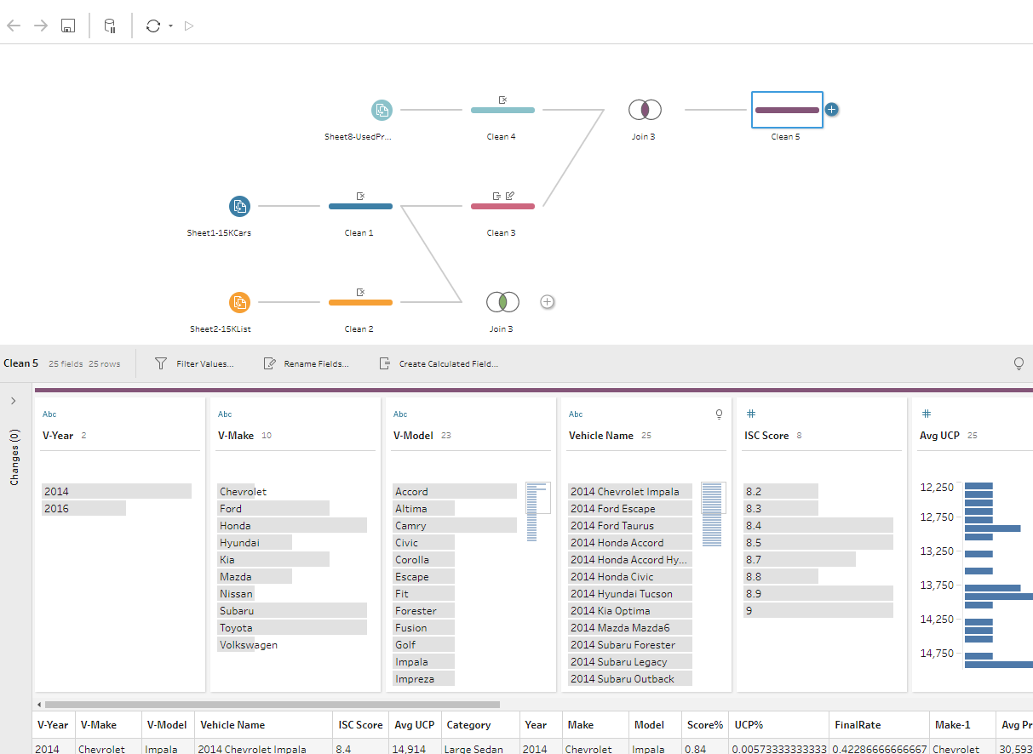
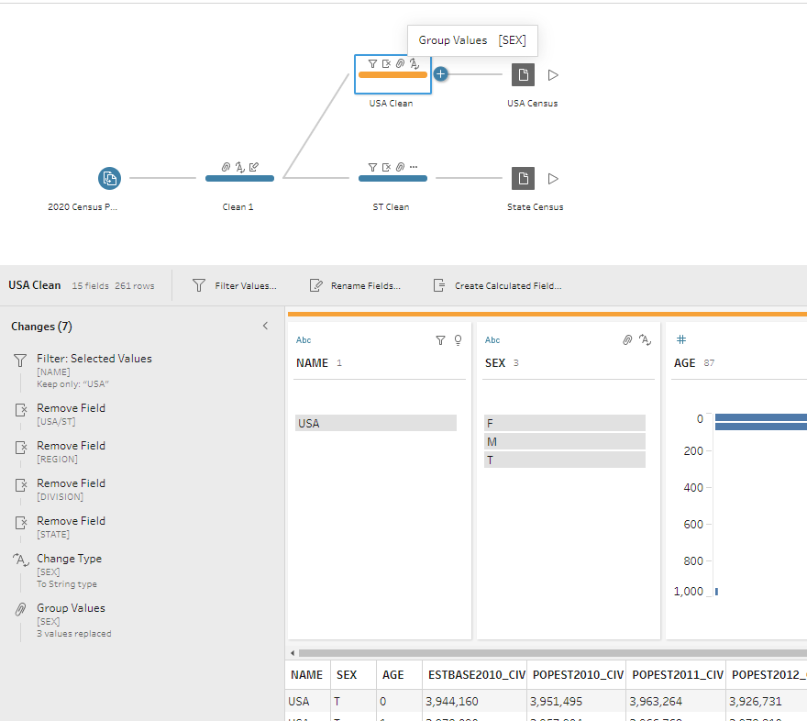
Tableau Prep Utilization
Notes:
Joe
Now that we have gone through and gathered all the data and done an initial layer of data filtering and processing. This data was then saved into Excel Spreadsheets so that we would then be able to import the data sets into Tableau Prep and applying final filtering and merging of data sets together to be able to produce coherent visualizations. These included techniques of merging data sets on vehicle types to all for the ability to view crash safety data as well as recall information on the same visual.

Slide 22

Tableau Storyboard
- Address why these stakeholders
- Considerations for Financing – Credit Score
- Cost of car ownership > Cost of the car
- Paying for Less Value over time
- Not all cars are created equal
- Address why all these factors should be addressed.
Notes:
Joe
With all this information being processed and presented we are then looking at the reasoning behind the selection of the target group. The reason that we are selecting the target group is that we have identified a common gap in knowledge that being we see needs to be filled. With the Target age group the education that is taught will have a cascade affect in bigger decisions later in life. This program will bring light to the influence that a credit score will have in the process of financing something. It will also be instructing that when you have a car payment that you will also incur additional costs beyond the monthly financing payment. It is also being taught that the vehicle that is being purchased will become less valuable with time and affecting trade in or resale value.
The end goal of teaching all this information is to allow a group of people to be able to make an educated decision of what is typically there first big purchase as an adult and be able to make a sound decision on purchasing a car and with that education be able to translate those skills and resources into other purchases being made later on in life.

Slide 23
Technical Challenges
Joe’s issue with the NHTSA website
Maria’s file with 400,000 rows
Notes:
Joe
With any project there are road blocks and issues that can come about. Our issues mainly presented themselves in two main issues that we encountered. Both of these issues were encountered in the data gathering process. The first that was encountered what in gathering Safety Data from the NHTSA website. There API documentation did not give specific limitations to maximum requests that could be placed to the website which ended up with us encountering error due to the API blocking my IP address for 48 hours. We were able to curtail this issue with two solutions. First was implementing a pause in between individual requests and the other was the changing of IP addresses while making requests to avoid getting another IP address blocked. The second issue was being caused by the Size of a data set that was gathered through the scraping of data from Craigslist. Before processing of the data it was an excel spreadsheet with over 400,000 rows of data. This was managed through direct cleaning, cleaning through python as well as Tableau to be able to get the needed information down to a manageable size.

Slide 24
Time Enhancements
Further education on how FICO scoring is calculating and steps to take to build/improve your score.
Create automatic safety and risk report when a vehicle is selected.
Comparing rates and payments for New versus Used.
Notes:
Joe
Looking at this project and looking forward to the expansion of the project if there was more time available the first task that would have been covered is expanding on the financing information for cars and giving separate information based on whether the buyer is purchasing a new or used vehicles. We would also dive into the factor and techniques that are used to calculate as well as improve a person’s FICO score. Lastly we would be wanting to work towards being able to produce an automated safety report for a vehicle that would be selected by a user.

Slide 25

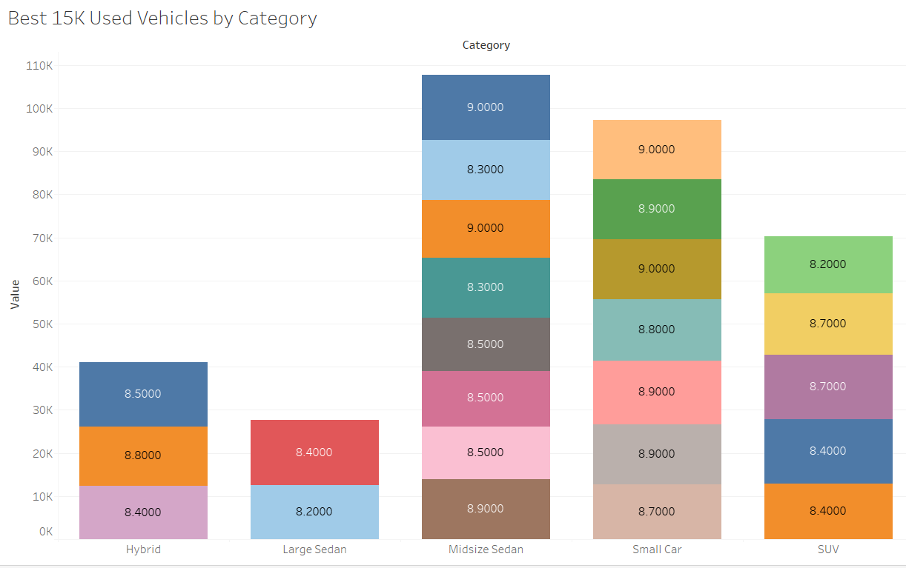
Hypothesis Tie-In
Hypothesis Proven:
YES
Notes:
Yes, it was: we hypothesize that the vehicles supplied on the data set pulled from ISeeCars.com identified that they have the highest safety ratings and lowest cost of ownership. The visual shown here pulls data for best used vehicles at or under $15k vehicles by category. Thus, confirming out hypothesis.

Slide 26

Conclusion
Ask yourself …
“CAN I AFFORD IT?”
Is your FICO score high enough to obtain a low interest rate loan with an affordable monthly payment?
What are the expected annual costs in my area?
Is the monthly insurance premium manageable?
Notes:
Andrea
In conclusion – before making your purchase, your very first question should be “can I afford it?” As we saw today, your FICO score will directly correlate to your interest rate which will then correlate to a larger total overall expense over the life of the loan. Additionally, the state you live in will affect the annual costs & repairs, as well as your monthly insurance premium as we saw can be quite substantial depending upon the state. We hope that you have found this insightful and helpful in your journey and good luck in your search!

